Slide 1

Corporate Governance MG 5326
Class 2
Roles & responsibilities of the board and management

Slide 2

Legal Framework
Legislation confers the management of the business of the organization on the board of directors
The board acts as a collegial body inspired by the parliamentary model – discussion and resolution
The board can delegate certain of its powers to enable it to achieve its goals

Slide 3
Legal framework
Corporate law sets out the following duties:
Fiduciary duty (duty of loyalty)
Duty to act honestly, in good faith and with a view to the best interest of the corporation
Avoid conflict of interest
Duty of confidentiality
Duty to disclose
Imposed on each director
Duty of Care
Duty to exercise the care, diligence and skill that a reasonably prudent person would exercise in comparable circumstances

Slide 4
Statutory sources of director responsibility
Companies/ Corporations Acts
Labour Laws
Securities Acts, Regulations, Policies
Environmental Laws
Criminal Code
Bankruptcy Act
Anti-money laundering
Etc
etc

Slide 5
The role of the Board
An effective board is dedicated to ensuring the
organization reaches its objectives by explicitly
assuming responsibility for :
Corporate strategy
Identifying, assessing and evaluating the principal business risks
Succession planning
Communications policy
Integrity of internal controls and management information systems
Developing the organization’s approach to corporate governance

Slide 6
The effective board
Qualities required of a director:
integrity prudence experience
discretion diligence availability
independance loyalty competence
objectivity training leadership
knowledge teamwork
_______________________________
Availability, Competency, Integrity + …

Slide 7
Effective boards need independence
Independence in Fact :
Not subject to control by others - neither fear nor favour
Independence from management
Independence from controlling shareholder
Based on definitions - structural
Local securities regulations’ definition of independence
Independence of Mind
Think, speak and act independently with confidence and courage
Be critical and responsive to change and new thinking
Have confidence and the will to make tough decisions, including the strength to challenge the majority view
Be willing to risk rapport with Chair and other Directors and / or C.E.O. in taking a reasoned, independent position

Slide 8
Board composition
Number of directors
Term
Mix of expertise/qualities
‘chemistry’
Consistency of vision and scope
Shared values
Effective Boards =
Trust and candour
Culture fostering open dissent
Individual accountability
Evaluate their own performance

Slide 9
Board dynamics
Meetings
In camera meetings
Separation of the roles of Chair/CEO
Lead directors
Committees
How many?
Effective mandates/charters
Board and Director evaluations
Role of the Corporate Secretary

Slide 10
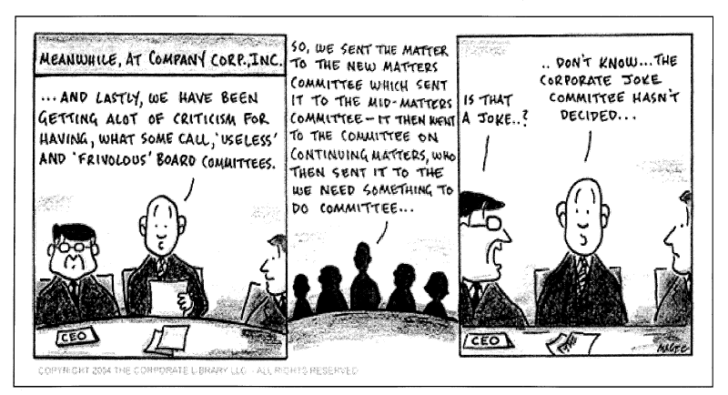
Committees

Slide 11
Basic rules for committees
Membership appropriate to purpose
Keep board informed of activities
Actions should be within limits of mandate and law
Authority and function clearly defined
periodic review of responsibilities

Slide 12
Essential components of committee mandate:
Purpose
Responsibilities – review,recommend,approve, report
Membership qualifications
Appointment/removal process
Structure and operations
Ability to sub-delegate
Reporting frequency to board
Authority to engage outside advisors

Slide 13
Audit Committee
main roles* :
Monitor financial statements
Review internal financial controls
Review internal control and risk management system
Monitor internal audit function
Recommend and oversee selection, and approve remuneration of external auditors
Review and monitor independence and objectivity of external auditors
Review whistleblowing arrangements
(* embedded in various regulations in the UK, US, etc.)

Slide 14
Compensation committee
All independent directors (recommended)
Written charter
Compensation set as a function of risk and responsibility
Compensation defines corporate culture
Access to an independent consultant
Remember impact of disclosure

Slide 15
Nominations committee
All independent directors
Written charter and access to an independent consultant
Skill set needed by the Board is an essential consideration
New directors must know and understand the business
Not all directors need bring the same skills
Avoid cronyism

Slide 16
Class two assignment
A two to four page essay on the following (please cite your sources):
(1)What was the background to the introduction of the Sarbanes Oxley Act (US) in 2002 and the more recent Dodd Franks Act and what are their main provisions? (2) How were these provisions intended to reduce the risk of corporate fraud? (3) Evaluate whether the objectives of the Acts have been achieved.

